Slide 1
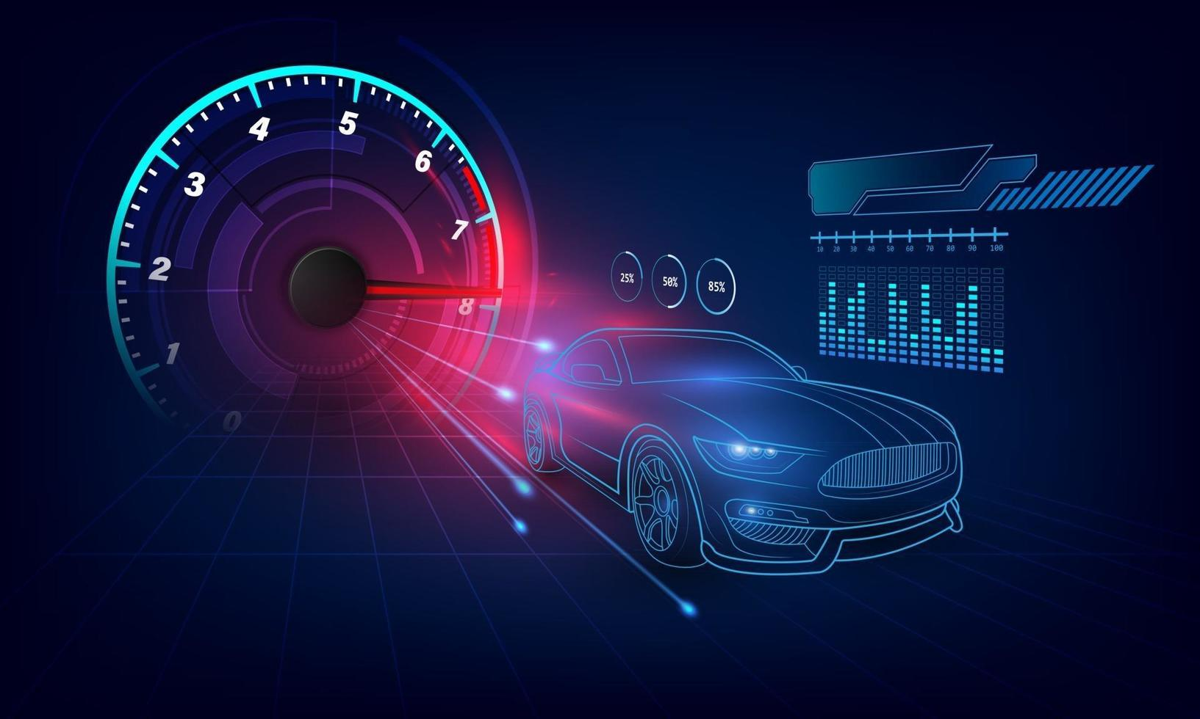
Unlocking Automotive Trends Project
Saravanan S

Slide 2

Introduction
Continuation of part1 Analysis
Focus on safety, comfort , alert system and dimensions
Data driven insights for business and product planning

Slide 3
Objective
Evaluate safety standards (ABS, airbags, hill assist)
Examine comfort features(Seating, central locking,child locks)
Conclude with business insights
Analyze alert systems(speed alert,seat belt,door warnings)
Study size trendsthroughdimensional analysis

Slide 4

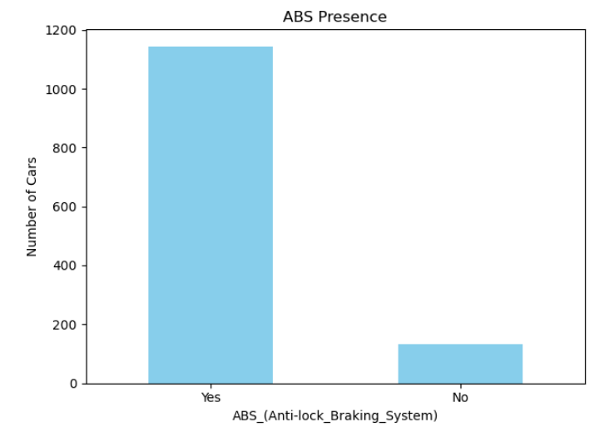
Safety Feature Chart Code Snippet
ABS is available in most models indicating strong safety norms
Hill assist is limited, suggesting it's present in higher-end variants
Airbags average between 1–2, with some high-end models offering more

Slide 5

Average Seat Capacity
Make | Seat Capacity
Icml | 8
Mitsubishi | 7
landRover | 7
Mahindra | 6
Land rover rover | 5
Isuzu | 5
Toyota | 5
Renault | 5
Force | 5
Kia | 5
Volvo | 5
Honda | 5
Lexus | 5
Tata | 5
Maruti Suzuki | 5
Audi | 5
Ford | 5
Icml Model having 8 seat capacity Mahindra and Landrover offer the highest seating capacity, indicating a focus on family or multi-passenger vehicles

Slide 6
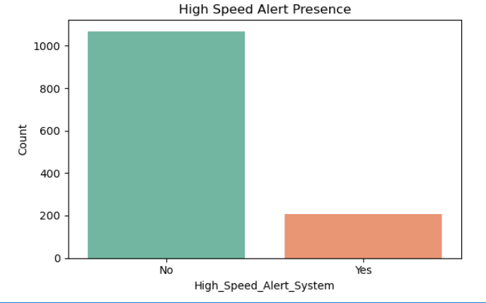
Alert Systems – High Speed Alert
High-speed alert systems are present in a majority of the vehicles, indicating alignment with new safety regulations. Lack of this feature in some models suggests outdated or entry-level trims.

Slide 7
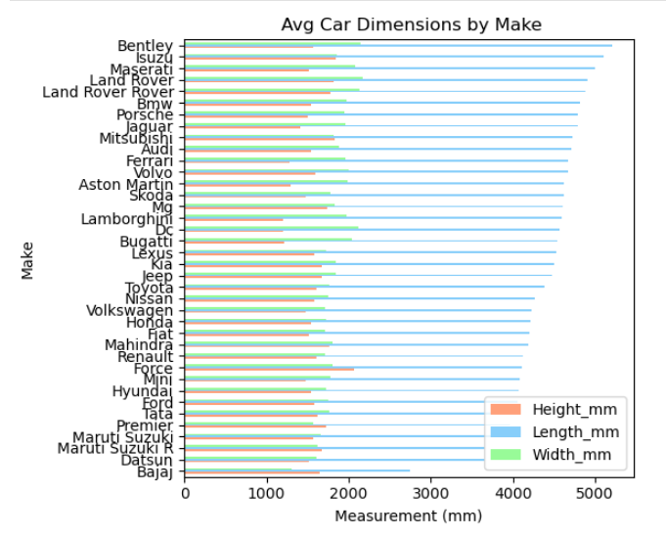
Avg Dimensions by Make
SUV brands like Bentley and isuzu show larger average dimensions, supporting their position in the premium and utility segments. Tata and Hyundai stay compact, favoring urban mobility.

Slide 8

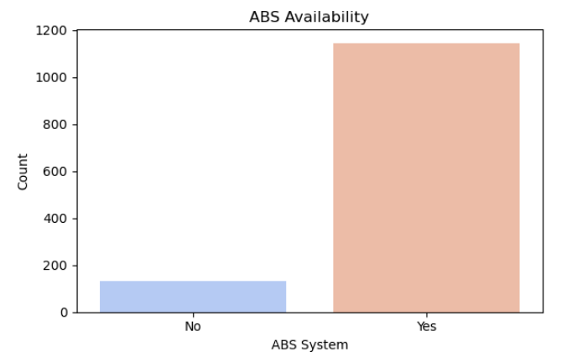
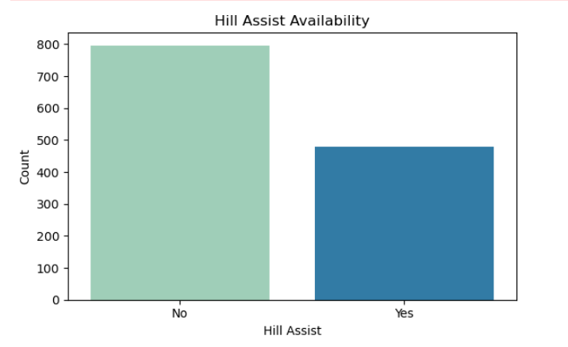
Safety Feature Assessment
ABS is widely available, showcasing strong safety compliance.
Hill Assist (not visualized here) is present in fewer models, typically premium.

Slide 9
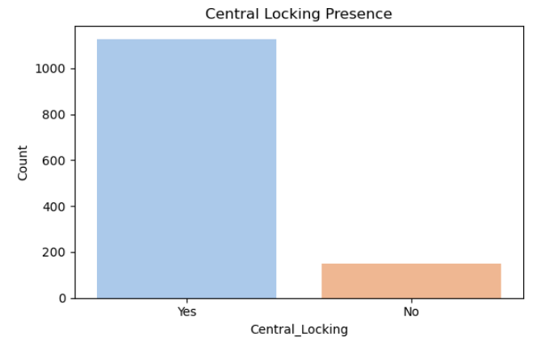
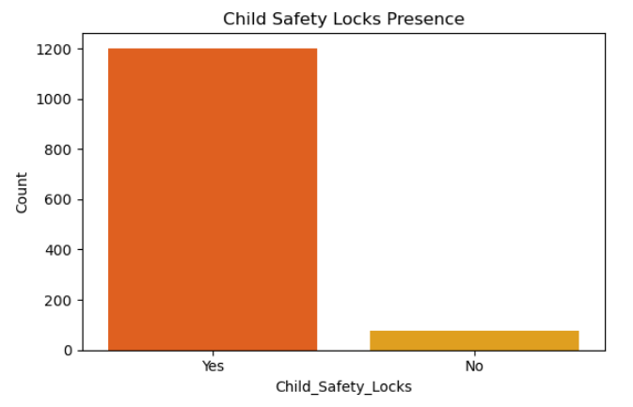
User Comfort Exploration
Mahindra and Honda offer higher seating capacity, suiting family or utility purposes.
Central locking and child safety locks are commonly available in most modern vehicles.

Slide 10
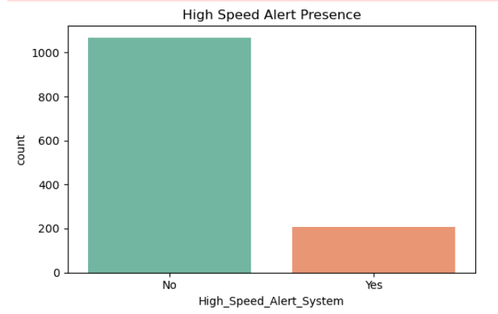
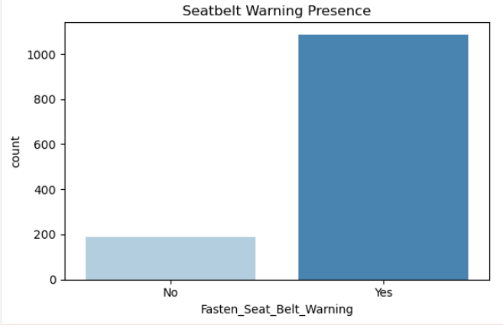
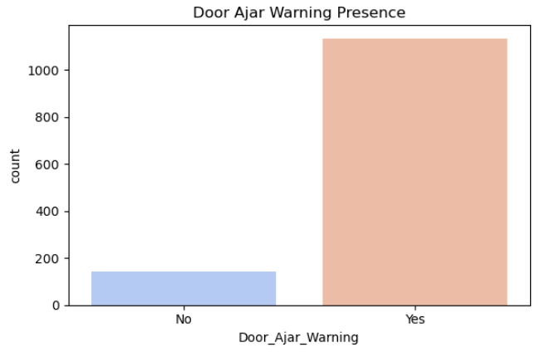
Alert System Analysis
High-speed alerts and seat belt reminders are prevalent, indicating regulatory compliance.
Door ajar warnings are widely adopted across makes.

Slide 11
Business Conclusions
Ensure safety feature standardization
Compact cars lead urban markets suv suit premium buyers
Promote models with comfort & alert integration for families
Use dimensional insights for future vehicle planning

Slide 12
Challenges & Future Scope
Challenges:
Inconsistent labels (Yes/yes/NaN)
Missing/ambiguous numeric values
Future Scope:
Predict safety/mileage using ML
Add price & customer feedback for deeper insight
Feature benchmarking for competitive analysis

Slide 13

THANK YOU

